Slide 1
Welcome

Slide 3
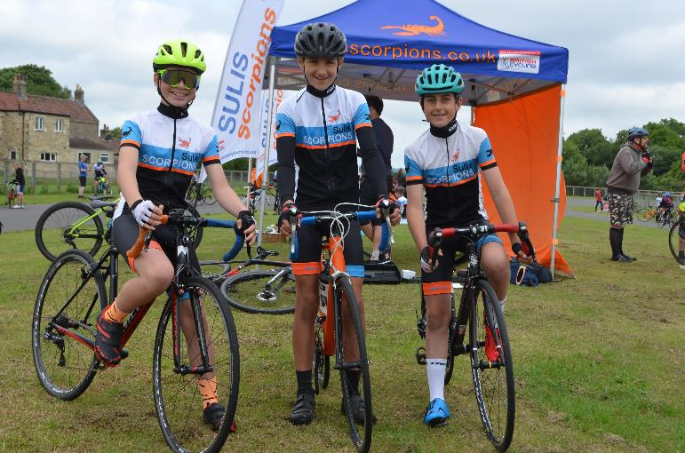
Annual General Meeting & Rider Celebration2022 Sunday 8 May 2022 1000 - 1200

Slide 4
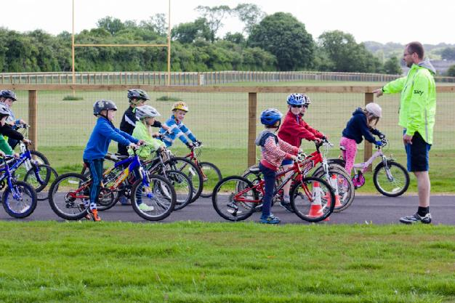
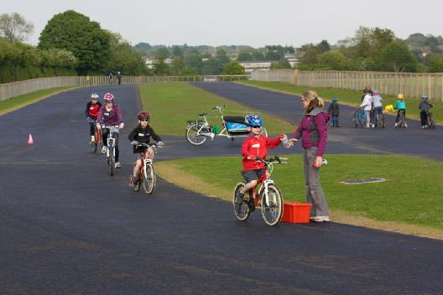
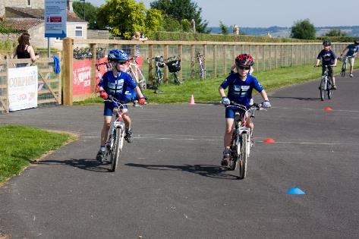
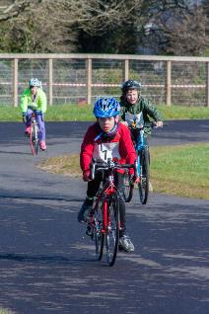
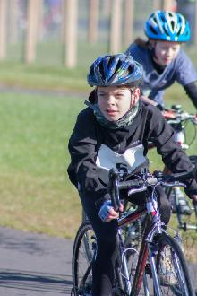
Rider experiences
Harry and Jacob Barnett (members since one of our first induction courses in 2013) Thank you very much for the last 9 years. It has been a pleasure. We have decided due to our very busy schedules that we will stop being a part of Sulis Scorpions, but will keep cycling. We have thoroughly enjoyed our time with the club and have grown as people and riders along the way.

Slide 5
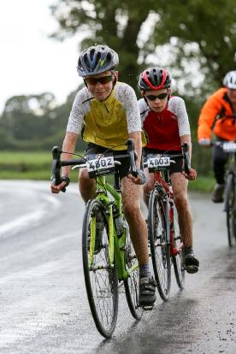
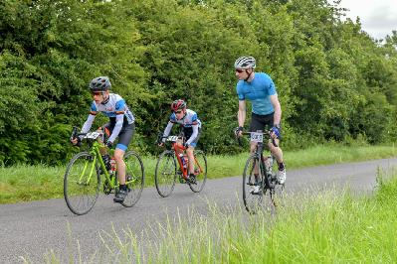
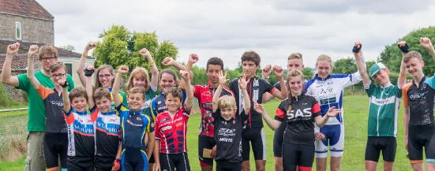
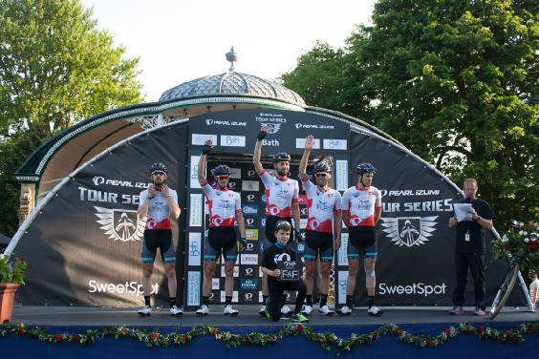
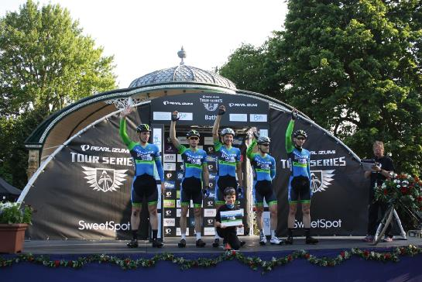
Rider experiences It has given us many great opportunities such as leading out the Tour of Britain. Cyclocross was always brilliant fun (especially on road tyres) though not sure about running in cleats. The small group races in sessions were excellent such as Italian pursuit and derny mass sprints, especially against Jack. We’ve enjoyed many sportives - the best with other Sulis members.

Slide 6
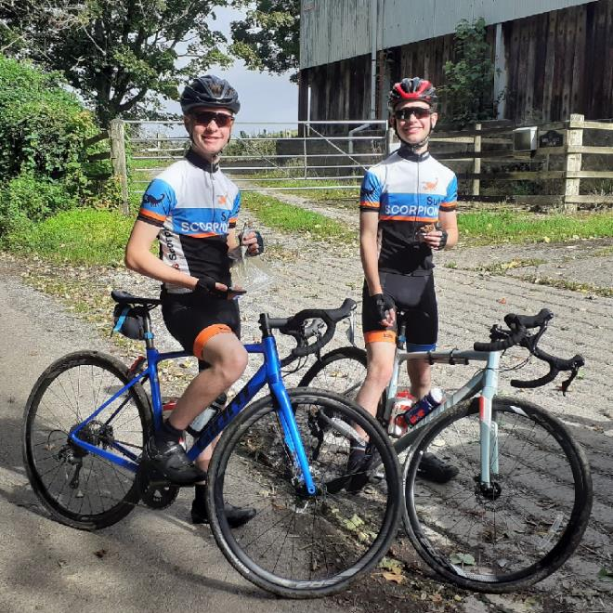
Rider experiences Thank you to all the coaches for their enthusiasm and knowledge every Saturday.
Coaches experiences Thank you Harry and Jacob for your commitment, smiles and effort, like so many a credit to the club - good luck and “see you up the road”………

Slide 7
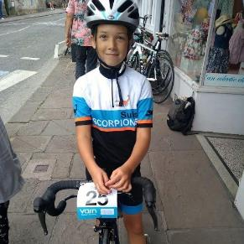
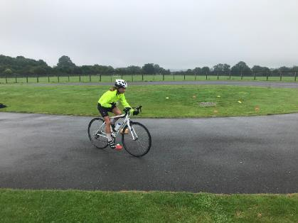
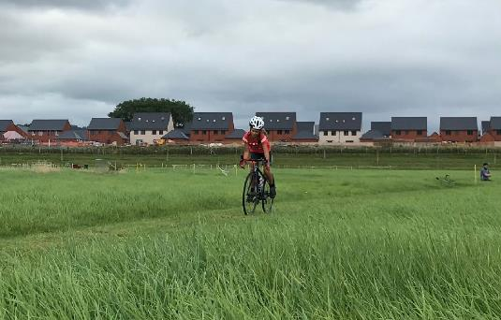
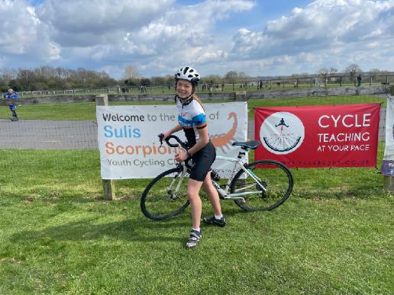
Rider experiences
Tessa and Elen Dixon
Tessa - I started cycling at Sulis Scorpions age 9 after a friend recommended it to me on return from a cycling holiday in France.
I have loved the competition and the skills it has taught me and has become a big part of my weekly routine. After 4 and a half years I have started cycling at Avid and still enjoy coming to Scorpions to see friends and learn new skills.

Slide 8
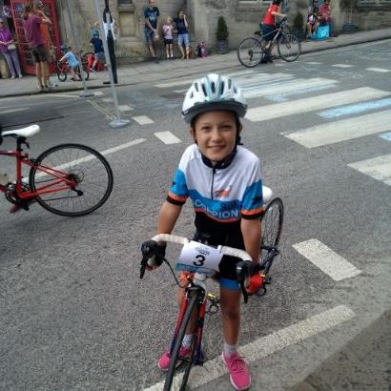
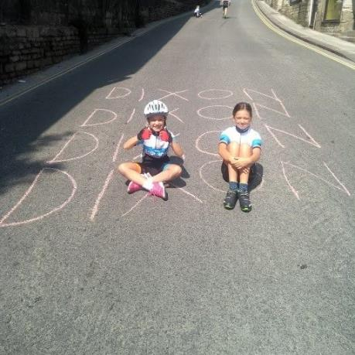
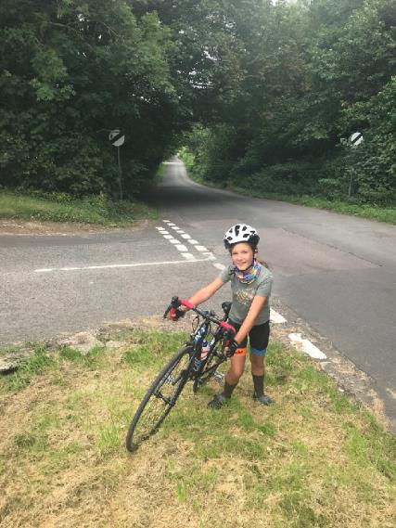
Rider experiences
Tessa and Elen Dixon
Elen - I started cycling at Sulis Scorpions age 8 because of my sister. I love the friends, fitness and the fun we have at odd down every week.
I enjoy the race days and look forward to a hot chocolate when I have finished.
The fitness and discipline that I have gained from Scorpions has allowed me to achieve goals in other sports as well.
Coaches experiences Thank you Tessa and Even, great work and keep it going, true “girl power”………lots more to come :)

Slide 9
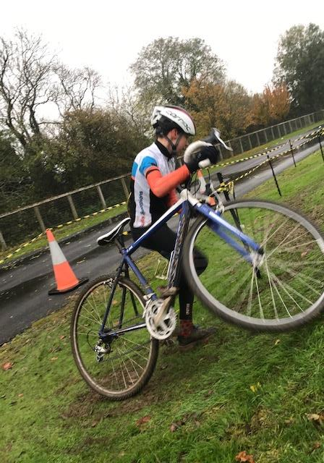
Welcome Annual Report Proposed changes to Constitution Election to Committee – Yr #3 Election to Committee – Other Roles Plans for 2022 – 2023 AOB

Slide 10
Who Are We?
Committee:
Chris Crowther Chair
Steve Glass Vice-chair
David Phillips Secretary
Eugene Kertzman Head Coach
Simon Bateman Treasurer
Robert Weeks Membership Secretary
Siobhan Waterworth Club Welfare Officer 1
Gareth Dixon Club Welfare Officer 2
Jenson Harris Youth Co-ordinator
Ryan Cains Volunteer Co-ordinator
Coaches (British Cycling trained)
Ryan Cains Level 2
Chris Crowther Level 2
Sarah Crowther Level 2
Jason Dodd Level 2, plus Track Award (Velodrome)
Steve Glass Level 2, plus Road & Time Trial Award and CX Award
Liz Hughes Level 1
Jenson Harris Level 1
Eugene Kertzman Level 3, Level 2 plus Road & Time Trial Award
Charlie Major Level 1
Alan Mowat Level 2
Simon Pearcey Level 2
Volunteers
Alex Morris
Amy Francis
Andrew Webber
Anna Dixon
Anthony Balzan
Bill Vallis
Chris Cannings
Diane Pearcey
Ed Tucker
Jean Yves Cherruault
Justin Goold
Karen Smith
Laurence Howard
Leon Gierat
Lucinda Weeks
Martin Harris
Mike Woodward
Phil Burton
Steve Baldie
Steve Burridge
Tim Cummins
Vicky Gierat

Slide 11
Annual Report 2021-2022

Slide 12
INTRODUCTION
Sulis Scorpions Youth Cycling Alliance was formed in April 2013 to enable young people to participate in cycle sport. We are based at the dedicated 1.5 km cycle circuit at Odd Down, Bath. Membership of the club is open to any youth or junior between the ages of 7 and 18 years who wishes to improve their cycling skills and/or develop their participation in cycle sport, regardless of sex, disability, ethnicity, nationality, sexual orientation, religion or other beliefs.
CLUBMARK STATUS
Joining a select group of cycling clubs across the country, in June 2018 Sulis Scorpions fulfilled the necessary criteria to achieve British Cycling’s Go-Ride Clubmark status. This prestigious accreditation was successfully renewed in July 2021. Clubmark is a universally acknowledged cross sport scheme introduced by Sport England for community sports clubs. It recognises high standards in welfare, equality, coaching and club management.

Slide 13
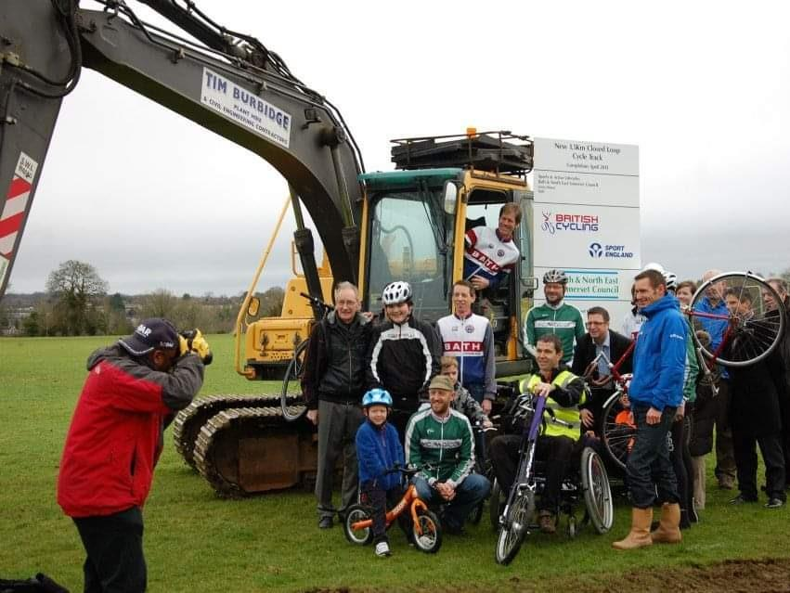
We’ve come a long way . .

Slide 14
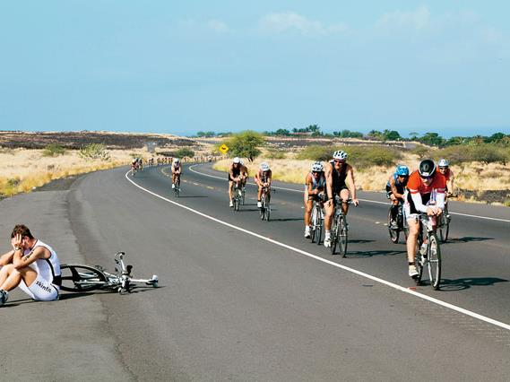
Bonking: A complete collapse of mind, body and soul

Slide 15
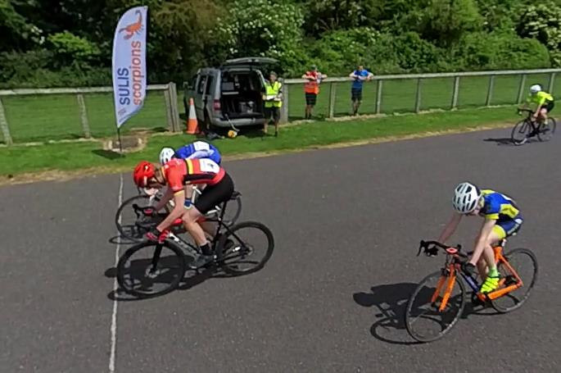
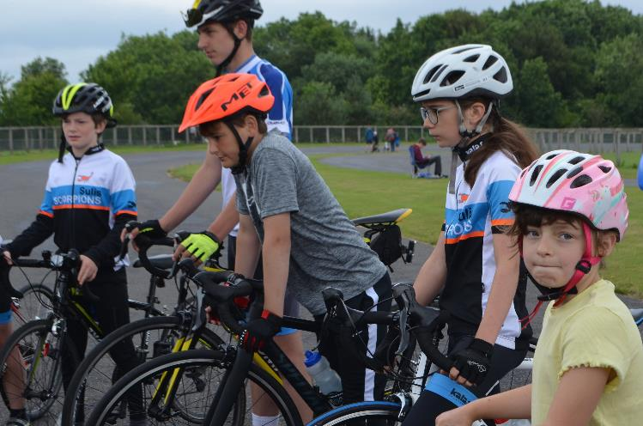
Chair’s Report
The pandemic is impacting our rate of progress but we have come a long way and the support of the committee, coaches and volunteers must never be under-estimated or taken for granted. I continue to highlight that without them there is no Sulis Scorpions.
We are midway through our 5 year plan – the details are in this deck. In some areas we are ahead and in others we are behind. Overall, we should be pleased with our progress. My concern areas are linked, primarily, with the recovery from Covid-19 and getting life back to normal so that will be the focus for the coming year.
Our committee continues to undergo significant change but is not beyond the norm and we are a victim of our own success. We have increased our volunteer and coach teams but these groups will always need support. My focus for this year has to be a more sustainable succession plan in place - this is the Club's biggest vulnerability going forward – the solution lies with the parents of younger members who may want to take on senior roles across the club.
Next year is our 10th birthday – we have some changes to put in place that will allow us to really celebrate this amazing achievement. I appeal to everyone in the club to ask themselves how they can support and sustain Sulis Scorpions? Your help, no matter how big or small, makes the difference, allows your children to enjoy the amazing sport of cycling and will take us through the next decade.

Slide 16
Sulis Scorpions - A Vision for the future
Ready
for the next decade
2024
Celebrating 10 amazing years
2023
A Sustainable Succession Plan
2022
✓
Keep it simple: Think Big
2021
✓
Consolidate & Certainty
2020

Slide 17
Treasurer
Report 2022
Treasurer Report
Sulis Scorpions maintains its secure financial situation with committee actively seeking best value for money opportunities to reinvest in the club.
During the accounting period 1 Jan 21 – 31 Dec 21 we had a deficit of income over expenditure of £3801.84, largely due to our investment in kit/clothing which has a current stock value of £7174.00, an increase of £3044.00 over the year. The club continues to discount the kit/clothing sold to our riders making it exceptional value and we cover the cost of Sulis Scorpion riders entering British Cycling races that we organise at Odd Down as well as discounting our popular Newport Velodrome trips.
Furthermore, the committee has purchased a number of bikes for use by new members and those looking to experience new cycling disciplines. This investment has been largely met by a significant grant awarded to us by Places to Ride and allows us to meet our commitment to bring high quality cycle coaching and enjoyment to a wider section of the community.
Simon Bateman
Treasurer

Slide 18
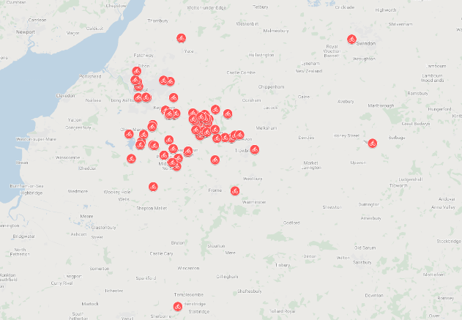
Membership Secretary Report 2022
CLUB MEMBERSHIP
The club currently has 110 youth members and 33 adult members (volunteers, coaches and committee). We have 26 female youth members, representing 23% of our membership. 66 (60%) of our youth members are in the under 12 age groups.
The impact of Covid continued to affect the size of our waiting list, at one point nearly reaching three figures and some children having been on the list since 2020. We have and continue to work hard to reduce this.
Our membership is close to full and space in the club has been at a premium as fewer children left and coaching capacity hasn't grown
Induction groups have now resumed, and bookings are already being taken for September 22
Due to several no shows on the February 2022 induction group, it was decided to move back to charging a fee for the induction course
The waiting list currently stands at 54 children. 23 of these are booked on future induction courses
The club moved to taking membership subscriptions via Direct Debit in May 2021, which has greatly reduced administration overhead in chasing missed payments and reconciliation
LEAVERS
41 children left the club between April 2021 and April 2022
Average age at leaving was 13
Most frequent reason cited was taking up other sports or moving on to other forms of cycling
Due to the large waiting list we also proactively contacted those who weren’t frequently attending to check whether they would be returning. This exercise saw 10 children leave the club
We come from far and wide!

Slide 19
Category | Total | Male | Female
U8 | 9 | 5 | 4
U10 | 22 | 17 | 5
U12 | 35 | 27 | 8
U14 | 27 | 20 | 7
U16 Junior Total | 15 2 110 | 13 2 84 | 2 - 26
Gender | Members
Female | 26
Male | 84
Group | Members
Whip | 18
Sand | 20
Emperor | 21
Striped | 23
Stalker | 14
Imperial | 14
Membership by age and gender

Slide 20
Coaching Groups and Racing
Head Coach Report 2022
Group name and time | Coaches
Whip 09:00 | Eugene
Sand 09:00 | Sarah
Emperor 10:00 | Ryan
Striped 10:00 | Alan
Stalker 11:00 | Steve
Imperial 11:00 | Jason
Assistant coaches: | Chris Simon Jenson Charlie Liz
Our aims:
Increasing access to cycle sport for young people
Developing core cycling skills for young people
Coaching young people to compete in cycle sport
Organising accessible, inclusive and enjoyable competitive cycle sport events for young people
Enabling young people to progress to club riding and other branches of cycle sport.
Provide volunteering and coaching opportunities for adults and young people to develop these skills in the cycling environment.
The Coaching Team:
We currently have a team of 11 coaches including three newly qualified. It’s great seeing young volunteers coming through and doing coaching qualifications! (Jenson). We still remain quite thinly spread when it comes to covering coaches ‘real world’ absences and it would be fantastic to have some more volunteers willing to train as coaches and we are now able to do an ‘in-house’ level 1 which means prospective coaches can go straight to level 2 once they have completed our little coaching induction program. We are keen to get more volunteers trained as soon as possible so if you are interested and haven’t yet been in touch then please let us know, it’s highly rewarding, great fun and you don’t have to be a cycling ex pro ninja! Funding is available for the training courses. Please speak to Eugene Kertzman for more information (headcoach@sulisscorpions.co.uk)

Slide 21
Coaching
The annual coaching programme is working well with all groups doing the same topic although at a different level. Induction takes place at least 3 times a year but some older riders are able to slot into the groups after a coach’s assessment. We have trimmed the coaching groups a little this year which means the Emperor bottle neck has now eased somewhat. 2021 has seen a return of most riders to attend sessions on a regular basis but some have dropped out and now left. We have also noticed that fewer riders have made the move to regular racing in the U16/U14 groups. We are still short of more female riders especially in the older age groups, we hope that our ‘That Girl Can’ programme will help to retain more girls.
Events for 2021:
3 Time Trials planned 2 took place
3 British Cycling open races, 2 took place
1 Cyclo Cross event, 1 CX event at Keynsham
TT & Club Race Results can be found here: http://www.chiptimingresults.co.uk/series.aspx?CId=61&RId=344
Events for 2022:
2 British Cycling Open Races
3 Time Trials/Go-Ride open races
1 Cyclo cross event
3 That Girl Can events (Circuit, BMX, pump track, velodrome)
Places to Ride
The new bikes have now arrived and the store has been re-configured and upgraded. We were fortunate to get 9 new Isla bikes despite the supply chain problems in the cycle industry. We are due to get 2 more bikes in June. The bikes will be used for events at Odd Down and other locations but they are not available for long term loan.
Sulis Scorpions Race Bikes Loan Scheme
We have a number of road racing bikes available for loan. If you think that you might need one for a period of time or find it difficult to afford a new bike right now a youngster has grown out of his/her current bike then have a word with one of the coaches or volunteers at the gate.

Slide 22
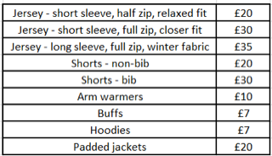
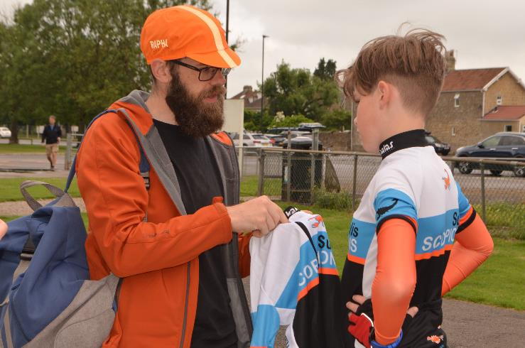
Club Kit
The club offers a range of Kalas cycling jerseys and shorts, plus hoodies, buffs and arm warmers for extra warmth, all in the distinctive orange and blue design. In addition we also offer padded jackets in black and orange. This continues to be popular particularly during the winter months.
Sales over the last year have been steady but we've sometimes had a challenge keeping some of the popular sizes in stock due to supply issues resulting from COVID. To counteract this we're now trying to keep more of the popular sizes in stock.
There was a small increase on some Kalas items at the end of summer 2021 and a further price increase on most items at the end of the year due to increased costs from our suppliers but the kit is still generously subsidised by the club and remains very good value.
The contactless payment system has proved a huge success and has also come in useful on club race days to collect day fees.
Our website has all the info on styles & sizes: https://www.sulisscorpions.co.uk/kit
and for any queries about kit, please email kit@sulisscorpions.co.uk
Kit sales
We try to have these once per month and details are communicated in the weekly members' bulletin and on the Facebook page.
Kit items and prices
Stock value

Slide 23
CLUB WELFARE
The club continues to put the welfare of our members at the forefront of all we do and adheres to the British Cycling Safeguarding Policy and our own Codes of Conduct. All coaches are aware of their welfare responsibilities and have received the appropriate training.
Following on from our call at last year’s AGM Siobhan joined the welfare team taking over the welfare 1 role from Amy Francis and joining Gareth Dixon who has continued in the role. This means we continue to meet our club’s requirement to have two Welfare Officers at all times.
We coped well with the challenges of having to introduce extra COVID procedures and measures to our Saturday sessions and it is great that these can now be relaxed again but we encourage continued COVID safe behaviour. Thank you to all the volunteers, parents and riders for your ongoing support with the changes we had to make.
If any child, parent, coach or volunteer has any concerns about the welfare of any club member, please do come and talk to Siobhan or Gareth, we can usually be found at the circuit on Saturdays. Alternatively please contact us both via email: welfare_team@sulisscorpions.co.uk . If you would prefer to contact us individually:
Siobhan’s email is welfare@sulisscorpions.co.uk and
Gareth’s email is: welfare2@sulisscorpions.co.uk
All concerns will be taken seriously and will be treated in confidence.

Slide 24
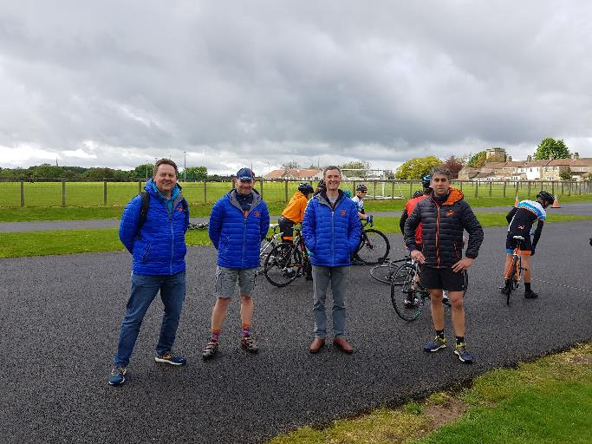
VOLUNTEERS
We are pleased to report that the Scorpions continue to be supported by an amazing team of volunteers and so on behalf of the committee, coaches and all of the Scorpions I want to say a big thank you to all of our volunteers.
2021/22 has seen the number of active volunteers decrease slightly due to older Scorpions moving on and taking their parents with them. Over the course of lockdown, this hasn't caused us any problems, however now that we are back, and with the extra challenges we have in order to operate in a safe way, we need more people to step forward and offer to volunteer.
Typical volunteer duties consist of controlling access to the circuit via the gate, marshalling, sign-on at races and time trials. If you would like to help, please feel free to talk to me (Ryan Cains - Volunteer Co-ordinator & Coach).
Without our Volunteers there is no Sulis Scorpions!

Slide 25
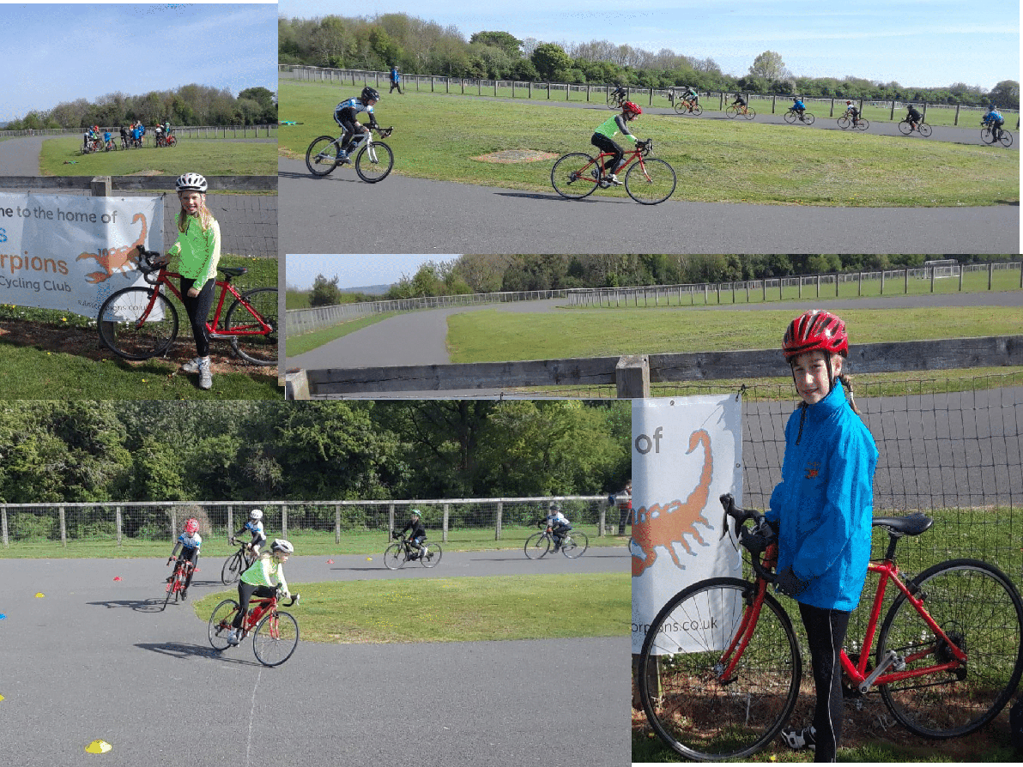

Slide 26
Constitutional Updates
Post COVID minor changes
Changes to the constitution require the votes of two thirds of the voting members.

Slide 27
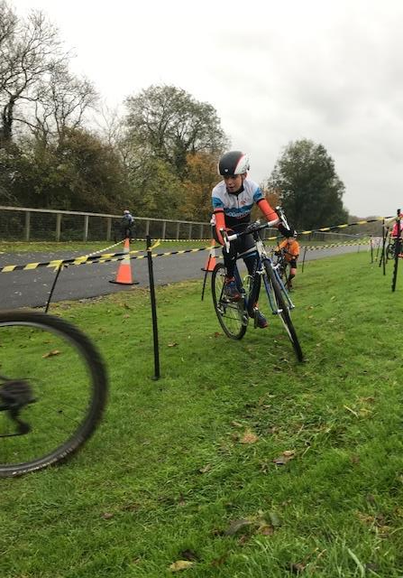
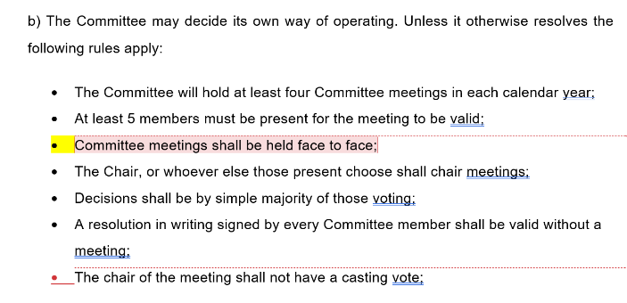

Slide 29
Election to Committee

Slide 30
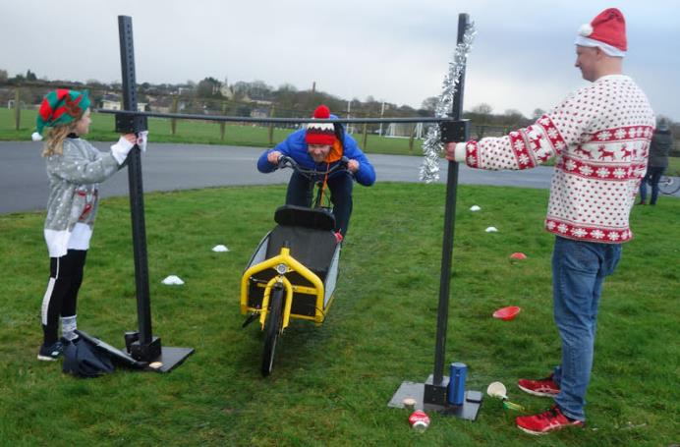
SECRETARY – David Phillips is stepping down - a volunteer is sought to fulfil this role.
VOLUNTEER CO-ORDINATOR – a volunteer(s) is sought to fulfil this role
WELFARE – a volunteer(s) is sought to fulfil this role
MEMBERSHIP SECRETARY – a volunteer(s) is sought to fulfil this role

Slide 31
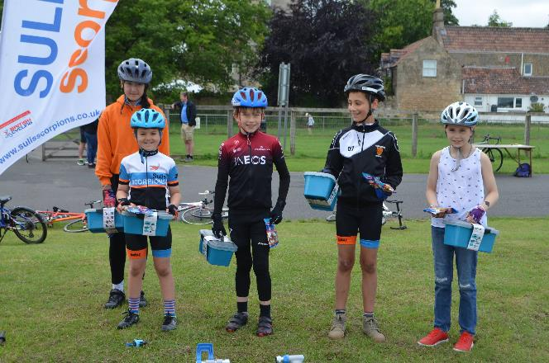
HEAD COACH (Year #2) – Eugene Kertzman wishes to step down to focus energy on Events (as a volunteer) - a volunteer is sought to fulfil this role
VICE CHAIR (Year #1) – Steve Glass wishes to step down – a volunteer is sought to fulfil this role
DIGITAL VOLUNTEER – Chris Crowther currently covers this role in addition to Chair and Coach. A volunteer(s) is sought to fulfil this role
BIKE LOAN CO-ORDINATOR(s) – a newly created volunteer volunteer(s) is sought to fulfil this role

Slide 32
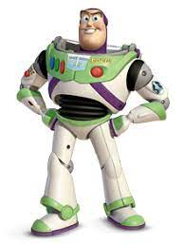
Through 2022 and beyond . . .

Slide 33
Sulis Scorpions - A Vision for the future
Ready
for the next decade
2024
Celebrating 10 amazing years
2023
A Sustainable Succession Plan
2022
✓
Keep it simple: Think Big
2021
✓
Consolidate & Certainty
2020

Slide 34
Sulis Scorpions Development Plan 2021 - 2024
The purpose of the Club is to promote the amateur sport of youth cycling in Bath & North East Somerset and community participation in the same area.
CORE VALUES
Safe & Accessible Club
Quality & Progressive Coaching
A Varied programme of competition & activities
Improve Club support and resources
Maintain Clubmark
Reduce Waiting List by 50% in 12 Months
Maximise Loan Bike scheme
Extend engagement with external groups
Promote diversity of membership
✓
Improve support for coaches and volunteers
Attract & develop (new) coaches in Road, Track and Cyclo cross
Deliver Progressive, inspiring coaching for all
✓
Circuit races (Go-R & BC)
Time Trials
CX Races
Hill Climbs
Track Visits
Sportives
Generate a sustainable succession plan
Deliver Places to Ride project / Remove barriers to entry
Achieve Community Amateur Sports Club status (TBC by committee)
✓
✓
✓

Slide 35
Objectives, Outputs and Activities
Obj #1: Maintain a safe and accessible club
Obj #2: Continue to improve the quality of coaching and ensure that it is progressive
Obj #3: Deliver a varied programme of competition & activities
Obj #4: Improve club support and resources

Slide 36
Objectives, Outputs and Activities
Obj #1: Maintain a safe and accessible club
ID | Output / Target | Partners / Stakeholders | Lead | Funding | Deliver By
1.1 | Maintain Clubmark | Committee, Coaches Volunteers, BC clubs officer | Fiona Vallis | N/A | 31 Aug 21
1.2 | Reduce Waiting List by 50% in 12 Months - SSYCC will Run more induction sessions to pull through candidates Formalise new induction process and publish on website | Coaches Membership Sec Head Coach Waiting List members | Head Coach Sp Membership Sec | N/A | 30 Jun 22
1.3 | Maximise Loan Bike scheme SSYCC will need to deliver the Places to Ride project This will allow SSYCC to increase its diversity offer (initial bike purchase as a key barrier to entry for less privileged) | British Cycling GLL Facilities Owners Wheels4All SSYCC Works Team Committee | Head Coach Sp Tim Cummins (SSYCC Store Manager) Vice Chair / Chair to provide due diligence – oversight (as required) | Match funding £5000 SSYCC Store conversion (£1000) | 31 Jan 22 31 Jan 23
1.4 | Extend engagement with external groups SSYCC will re-start and extend its offer of disciplines to its members SSYCC will lead on interclub “all inclusive” road races for regional youth clubs | Avid Sport – CX Entry Hill – MTB Calshot – Track Hd Coach - Inter-Clubs | CX – Vice Chair MTB – Simon Pearcey Track – Jason Dodd Inter-Clubs - | £1000 subsidy £500 subsidy £1000 subsidy £1000 subsidy (to be agreed with committee) | 31 Dec 21
1.5 | Increase female participation in the Club SSYCC will Run monthly female specific coaching sessions ‘This Girl Can’ Train a further 2 female coaches Increase our ratio for female riders from 21% to 30% | Coaches See target 2.2 | Sarah Crowther Sp Rob Weekes | N/A | 31 Mar 22

Slide 37
Objectives, Outputs and Activities
Obj #2: Continue to improve the quality of coaching and ensure that it is progressive
ID | Output / Target | Partners / Stakeholders | Lead | Funding | Deliver By
2.1 | Improve support for coaches and volunteers SSYCC will devise an aid memoire to demystify coaching Ensure that all coaches are aware of the benefits ie reimburse of costs and branded kit | Head Coach Coaches Volunteers | Head Coach Chair Sarah Crowther | N/A | 31 Aug 21
2.2 | Attract & develop (new) coaches in Road, Track and Cyclo cross SSYCC will Proactively work with volunteers and the community to identify Lvl 2 coaches (esp female coaches) Lobby BC to run a Lvl 2 course at Odd Down Push to run our own internal Lvl1 course | Potential coaches Head Coach Chair British Cycling | Head Coach & Chair | Usual subsidy of coaches qualification costs | 31 Mar 22
2.3 | Deliver Progressive, inspiring coaching for all SSYCC will Establish an annual calendar of skills and endurance based training Design a common, progressive syllabus that caters for all Clearly communicate the weekly plans to coaches in a timely manner Seek feedback (via coaches) on the effectiveness and quality of the plans | Coaches Members | Head Coach | N/A | 31 Aug 21

Slide 38
Objectives, Outputs and Activities
Obj #3: Deliver a varied programme of competition & activities
ID | Output / Target | Partners / Stakeholders | Lead | Funding | Deliver By
3.1 | SSYCC commits to deliver the following series of competitive and taster sessions for its members in 2021 – 2022 - Circuit races (Go-Ride & BC) | BC Odd Down Circuit Regional Youth Clubs Volunteers | Head Coach / SSYCC Race Organiser | £600 per event | 30 Apr 22
3.2 | - Time Trials |  |  |  | 31 Mar 22
3.3 | - CX Races | As above Avid Sport Keynesham Circuit | Vice Chair | £600 per event | 31 Mar 22
3.4 | - Hill Climbs (x1) | CTT Volunteers Regional Youth Clubs | TBD | TBD | 31 Oct 21
3.5 | - Track Visits (x2) | Calshot Volunteers Members | Jason Dodd | £1000 | 30 Apr 22

Slide 39
Objectives, Outputs and Activities
Obj #4: Improve Club support and resources
ID | Output / Target | Partners / Stakeholders | Lead | Funding | Deliver By
4.1 | Generate a sustainable succession plan SSYCC will Identify key posts that have been overlooked Actively encourage volunteers (esp those with younger members) to play a more active role in the key committee roles Seek to ensure that key roles are filled early Provide the necessary support and advisory to these roles | Committee Volunteers | Chair so by Committee | NA | 30 Apr 22
4.2 | Deliver Places to Ride project / Remove barriers to entry | See 1.3 | See 1.3 | See 1.3 | See 1.3
4.3 | Achieve Community Amateur Sports Club status (TBC) | Committee | Treasurer Chair | NA | 30 Apr 22

Slide 40
Through 2022 and beyond . . .

